Slide 1
Design Thinking Final Deliverable
20/20 Vision
Chris Stanko, Elizabeth Culkin, Lindsey Hume, Omkar Tamhankar

Slide 2
Wicked Problem
The normal schedule for working parents during the week generally lines up closely with this example:
Send kids to school either by the school bus or dropping them off
Kids return from school by the school bus or carpool/babysitter
With the COVID-19 pandemic, this normal process has drastically changed. In fact, part of the challenge presents in that there is no standard best practice followed by many households on how to manage working from home while helping kids attend school online from home as well.
How can we improve upon this paradigm by focusing on the experience of working parents amidst the “new normal”?
Go to work
Return from work
Cook dinner
Help kids with schoolwork
Put kids to bed

Slide 3
What Is
Research
Talking with mother who works from home and has a child completing school in the same household
Insights Gathered
Chaos of constantly being distracted from work to help with child's schooling
Parent must work & child must learn
Developing the Design Criteria
Enhancing the current COVID environment of learning & working
Working parent is professional
Child's learning is not compromised in any way

Slide 4
Design Criteria
Design Goal
Maintaining a professional persona
Maintaining a parent role versus a “teacher” role
Limit distractions
User Perceptions
Seamless implementation/transition
No additional complexity with maintenance
No additional complexity with maintenance
Maintaining work life balance
Functional Attributes
Separate workspaces
Separate workspaces
Physical Attributes
Increase sleep quality and duration
Reduce stress
Improve quality of education
Improve job satisfaction
Constraints
Time – work schedule vs. school schedule
Cost
Latency of implementation

Slide 5
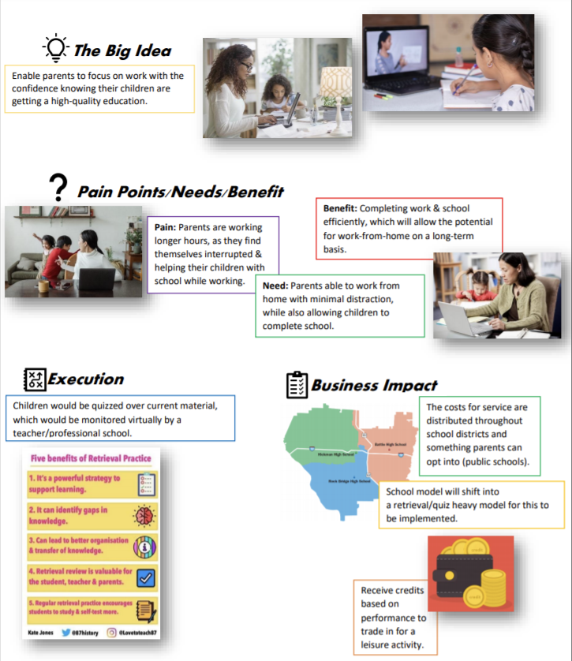
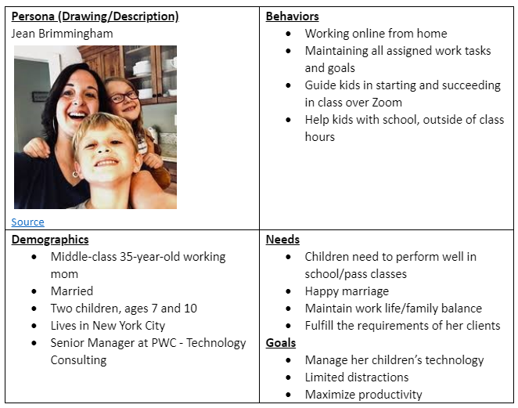
Napkin Pitch
Persona

Slide 6
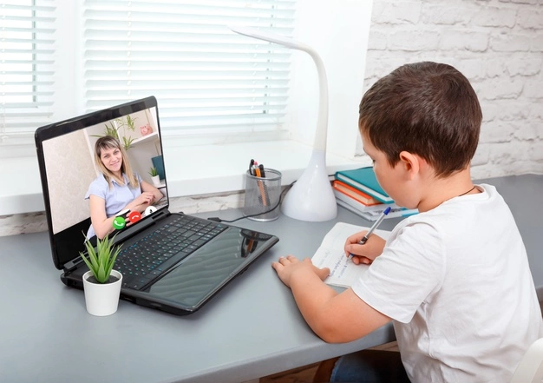

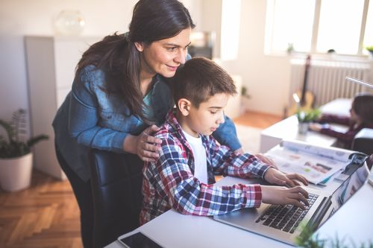
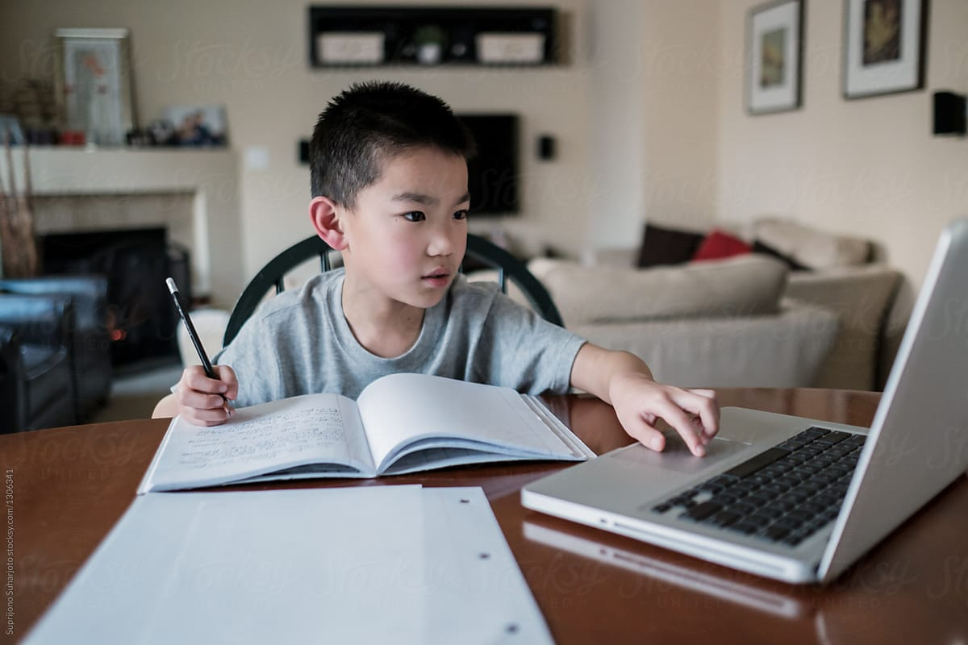
What If
GoGuardian for parents to monitor children’s computer
Dual/triple monitors – one solely for checking on the child
Physical workspace reconfiguration
Flexible work schedule to align exactly with children's
Both can be working simultaneously
Built-in 5-15-minute breaks to check on children
Hire a nanny/babysitter
New app that schedules, reminds, log-ins a child to their needed zoom session

Slide 7
What Wows

Slide 8
What Works?
Feedback
1. Public schools may refuse to make space in their budget for this third-party education quality assurance program
2. Parents may be unable to enforce token system, if they cannot supervise children's recreation
3. Distractions may not be fixed by this solution
4. School hours typically still do not align with working hours
Iteration – For version 2, we will focus on
1. Minimizing cost of implementation of this program
2. We will implement software to prevent sources of distraction on computers
Assumptions
1. Students attend class over a video conferencing platform, such as Zoom
3. The current virtual modality of education and work-from-home will continue for the foreseeable future
2. All instruction is online

Slide 9
In Conclusion
Reflection

